Slide 1
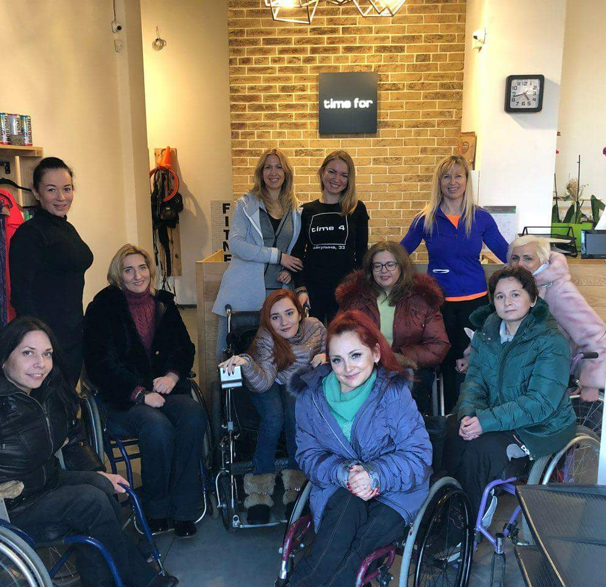

FLEX alumni grants programs
ACCESS THE APPLICATION HERE.

Slide 2
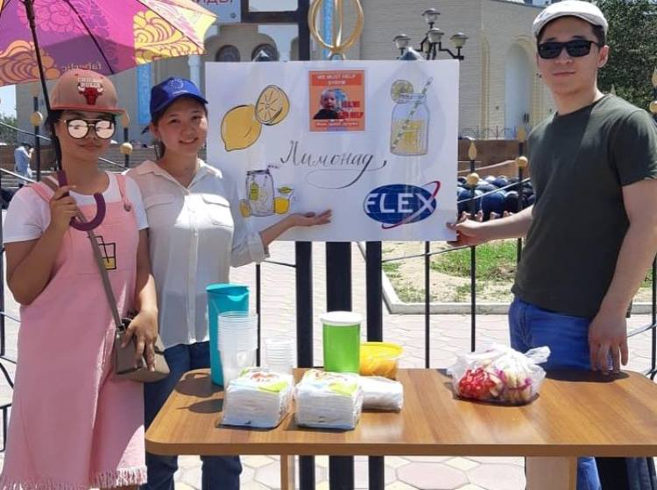
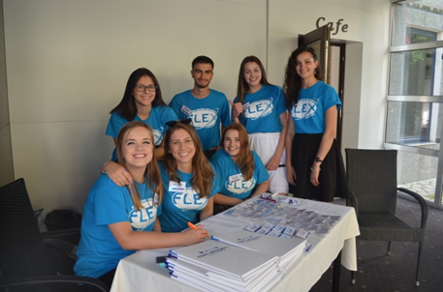
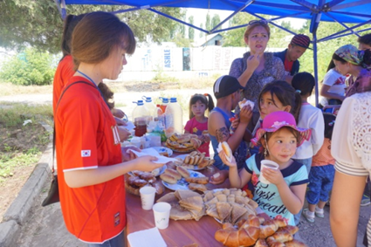
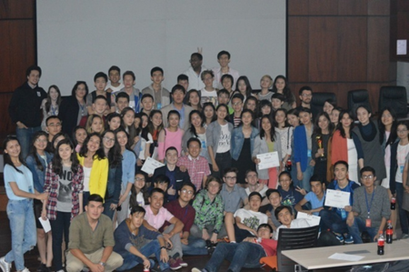
Goals of the Grants Program
Why are alumni grants important?
Who funds and who administers FLEX Alumni Grants?
To support alumni initiatives in their countries/regions
To help alumni develop professional skills in project
management
Funded by the U.S. Department of State,
Bureau of Educational and Cultural Affairs
Administered by American Councils for International Education

Slide 3
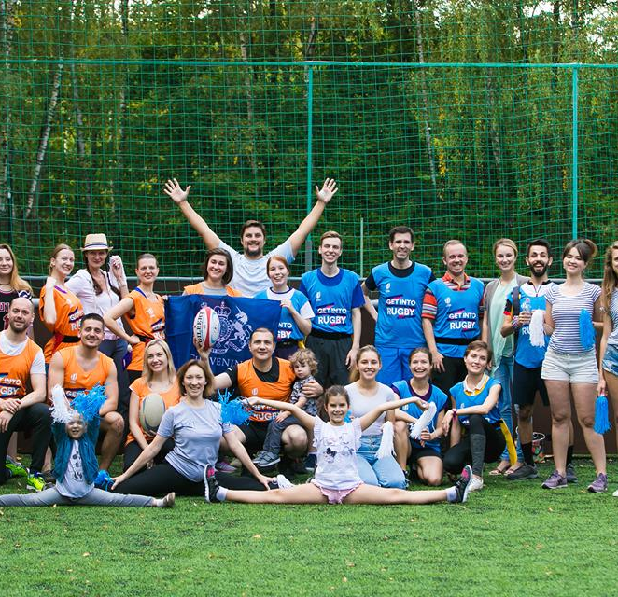
Types of Projects:
Community service projects
Projects to promote community involvement
Professional development activities
Projects to promote knowledge and understanding of English language and of US culture
Initiatives where alumni share skills that they learned while on the FLEX program with others
Any other projects judged to be in the spirit of the FLEX Alumni Program by the selection committee
Notes:
Support international education and research.
Advance the study and teaching of world languages and cultures.
Deliver only the highest quality educational programs.
Provide access to people from diverse backgrounds.
Provide necessary support structure and tools to ensure educational quality and outcomes.
Recognize our employees as our most valuable asset.
Develop and nurture lasting global partnerships.
Evaluate performance to ensure success.
Embrace diversity and respect for cultural differences.
Operate with fairness, transparency, and accountability.

Slide 4

FUNDING AVAILABLE
Travel Grants: $250
Individual Grants: $250
Group Grants: up to $3,000

Slide 5
Travel Grant: If you need funds (to buy tickets, accommodation, pay registration fee, etc) to attend a workshop/seminar/conference
You have to have letter of acceptance and willingness to share gained knowledge and experience with others when you come back.
Group Grant: The leader should be FLEX Alum and at least one group member should be of any US Government Program (UGRAD, FLEX, Fulbright, etc). You can invite any other non-alumni people

Slide 6
FLEX Alumni Grants Timeline
January 11: Application opens
February 11, 11:59 PM EST: Application closes
May:
Notifications

Slide 7
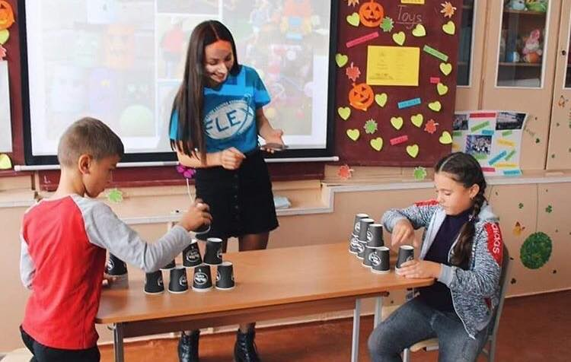
Financial Considerations
Financial Terms:
Budget changes must be approved by American Councils.
80% of funds are transferred upon receiving signed award letter, and 20% is sent upon receiving the completed report.
Each applicant is responsible for considering taxes and other fees that may apply to the grant award.
Each applicant is responsible for accurately completing their wire transfer documents.
IMPORTANT:
The program does not fund purchases of political activities working for or against a specific candidate or party or alumni salaries.
IMPORTANT:
The program will only fund durable equipment, T-shirts, prizes, gifts, or certificates when justification for these items is provided and does not exceed 30% of the program budget.
Notes:
Mission
A leader in international education, academic exchange, and overseas language immersion, American Councils creates opportunities that prepare individuals and institutions to succeed in an increasingly interconnected world.
Vision
American Councils is committed to helping build a world of globally competent citizens, successful institutions, and responsible nations.

Slide 8
What makes a strong application?
Cost share
Letters of support (from organizations with which you are partnering)
Past participation in FLEX Ability workshops
A budget without any unallowable items
A thorough budget- accounting for small details (such as bank fees, commissions, etc.)
Including an Emergency Action Plan
Thorough social media plan
Travel Grants: how will you share your experience with your community?

Slide 9
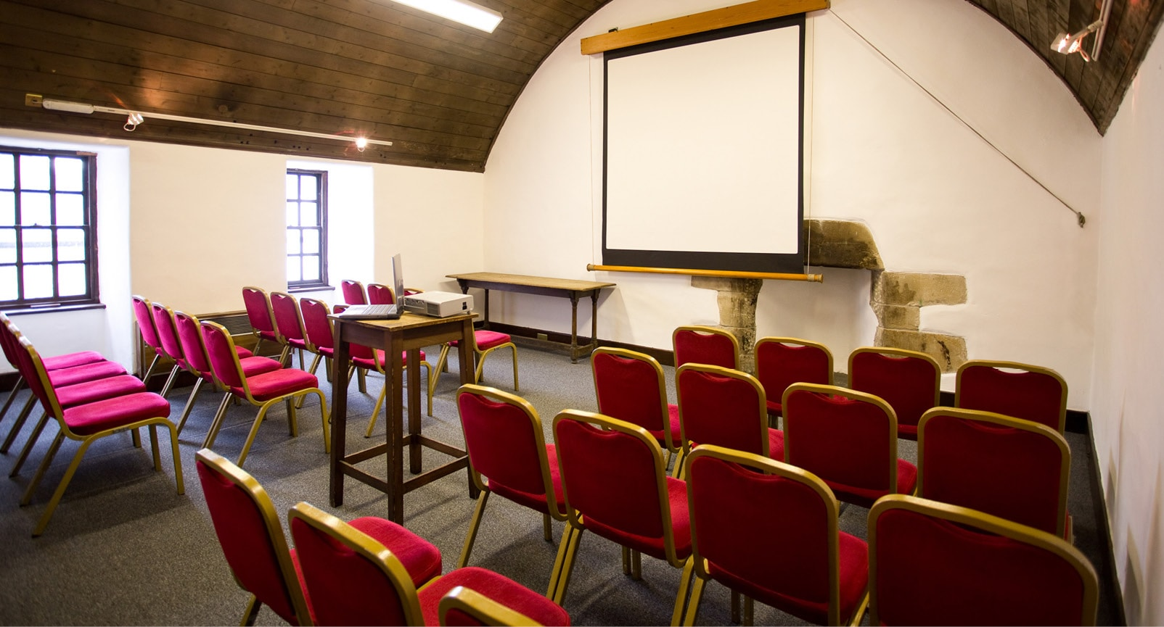









What can you get as an In-kind Contribution?

Slide 10

Questions?

Slide 11
BTW, This is a good opportunity to support your start up!

Slide 12
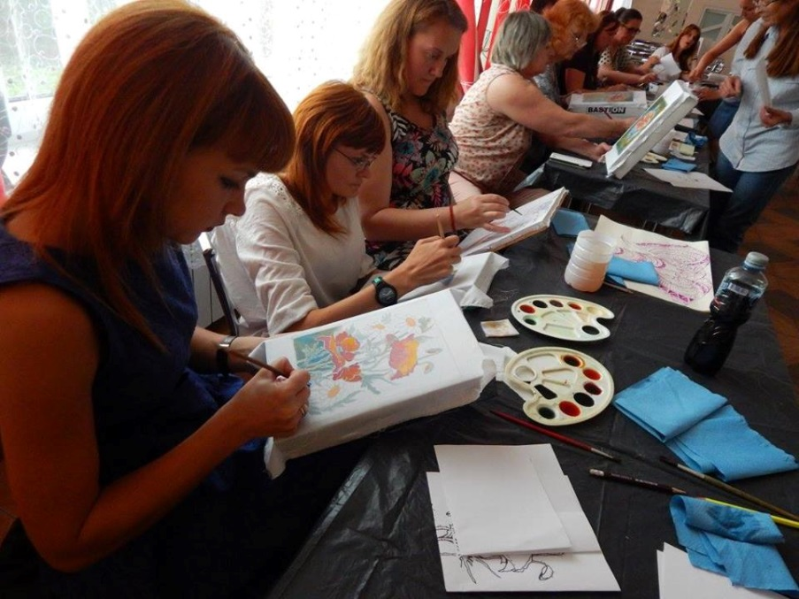
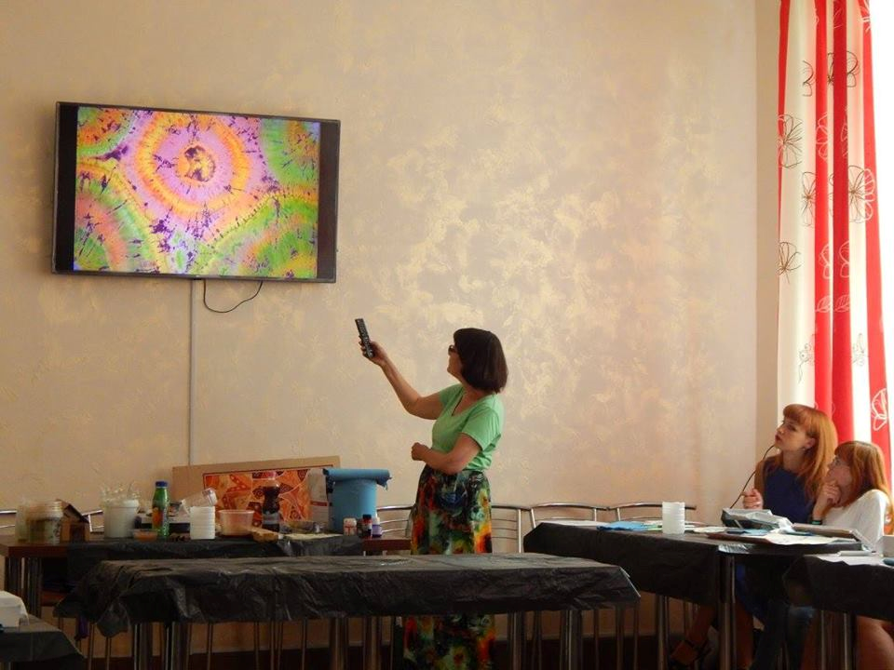
Example of FLEX Alumni project grant- Individual
Iryna Nadyukova ’14 organized a “Summer School of Arts” in Volodymyr-Volynskyy (Ukraine)
As an individual, Iryna received $247 in funding
Learn more about this projecton the FLEX Alumni West Ukraine Facebook Page.

Slide 13

Example of FLEX Alumni project grant- Group
“TechMothers” by Zhibek Kamalbek Kyzy ‘14: This ongoing project aims to teach computer literacy to mothers in rural areas of Kyrgyzstan, thereby increasing their chances of being employed.
The 5-person team received $1,765 in funding
See the video for her project here.
Notes:
On your application, you will be scored higher if you can show that you intend to extend/continue the project in the future.

Slide 14
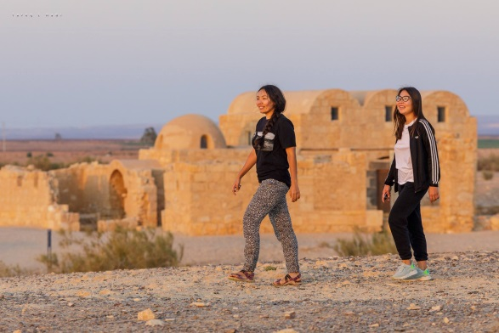
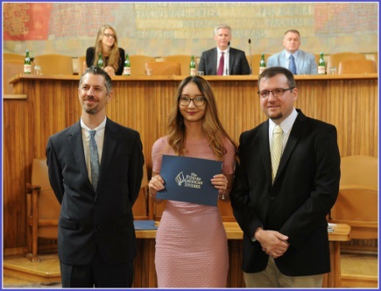
Example of flex alumni travel grant
Aizhan Kapysheva ’10 used a travel grant to travel to Amman, Jordan to serve as an intern for the Adolescent Development and Participation section of the UNICEF Regional Office for Middle East and North Africa.
Zhanar Tuleutayeva ’13 used a travel grant to attend a summer school program at the American Institute on Political and Economic Systems in Prague, Czech Republic.

Slide 15

“Be YOUNIQUE” Art school
Group Grant 1800$
Grant Recepient: Bibinur Zhamaliddenova
Bibinur led a team of 22 volunteers who organized an art project for 27 children of at the S.O.S Children's Village in Almaty. The idea of the workshop was to equip children with skills that can empower and assist them for future. The children took part in classes on drawing, created hand-made crafts, took dance and singing classes, and developed their public speaking skills through theater classes. After the children honed their skills in these various artistic fields, they participated and presented at numerous charity fairs, carnivals, community events, and art exhibits in the region. The artwork that the children created sold out at nearly ever fair they attended and the children agreed to use the funds raised to help pay for medical expenses of a friend of S.O.S villages that is battling cancer.

Slide 16



Slide 17
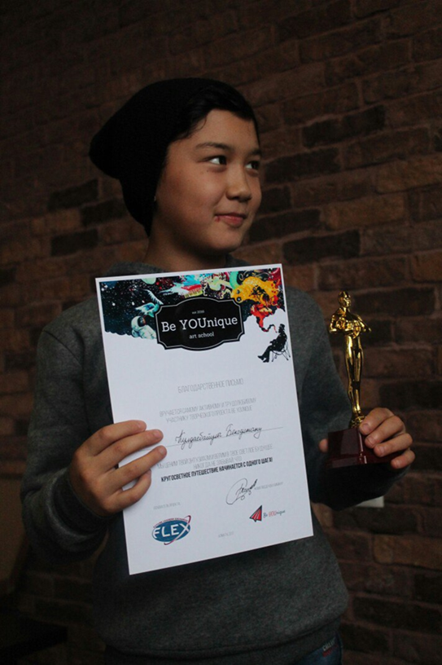
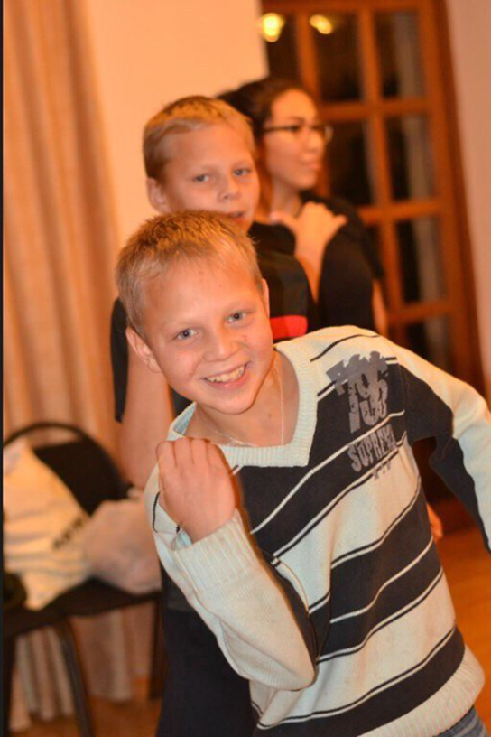

Slide 18
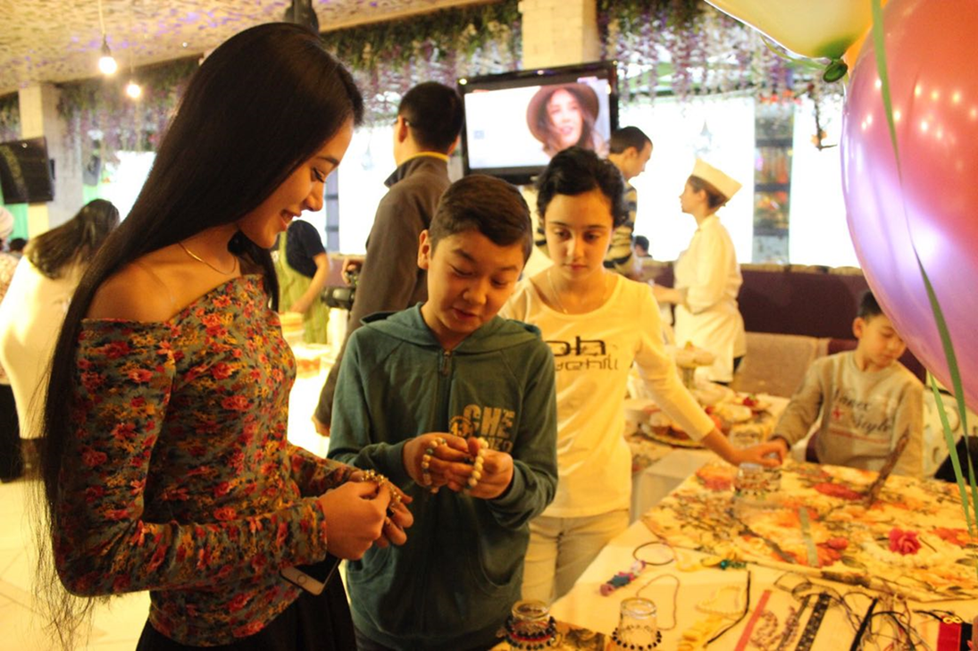

Slide 19
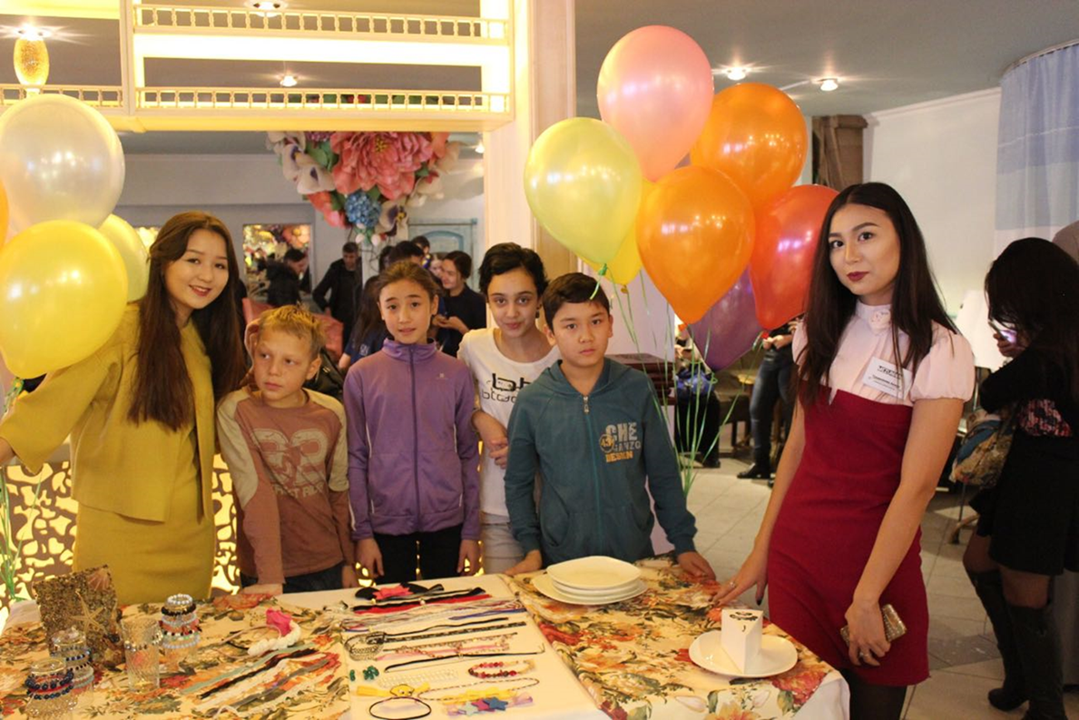

Slide 20
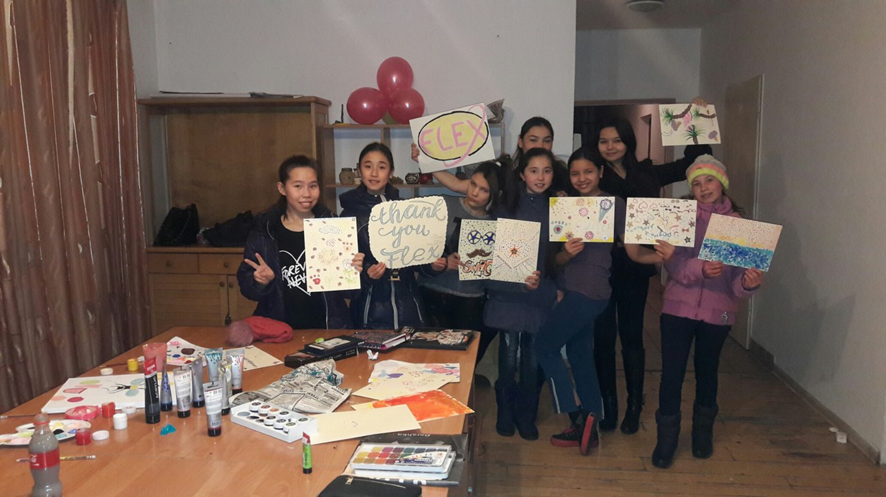

Slide 21
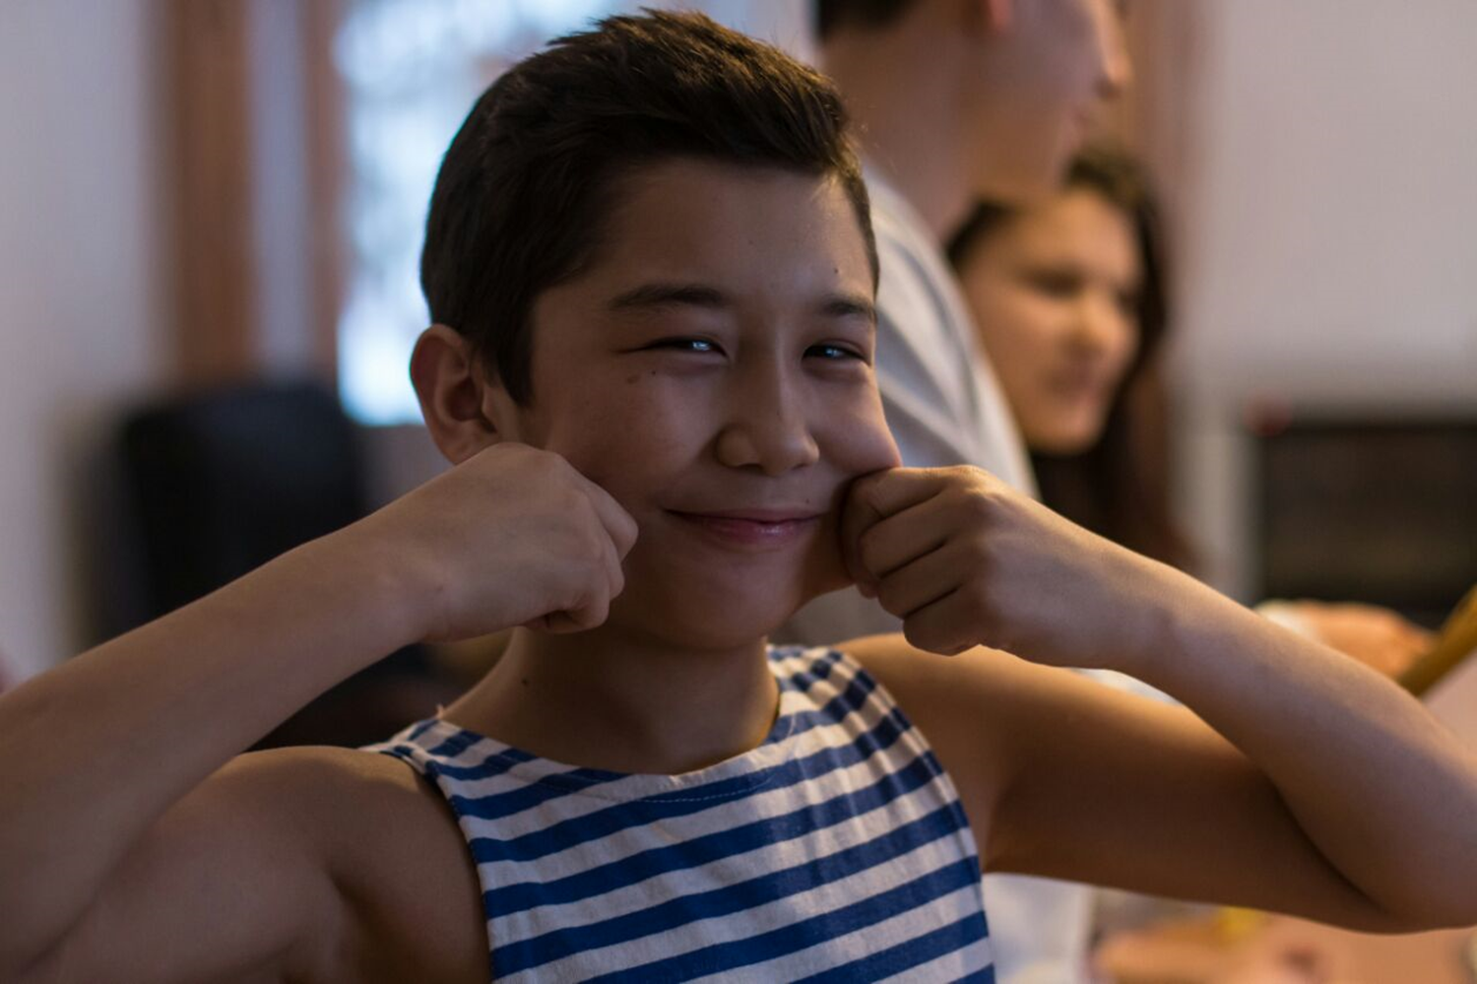

Slide 22
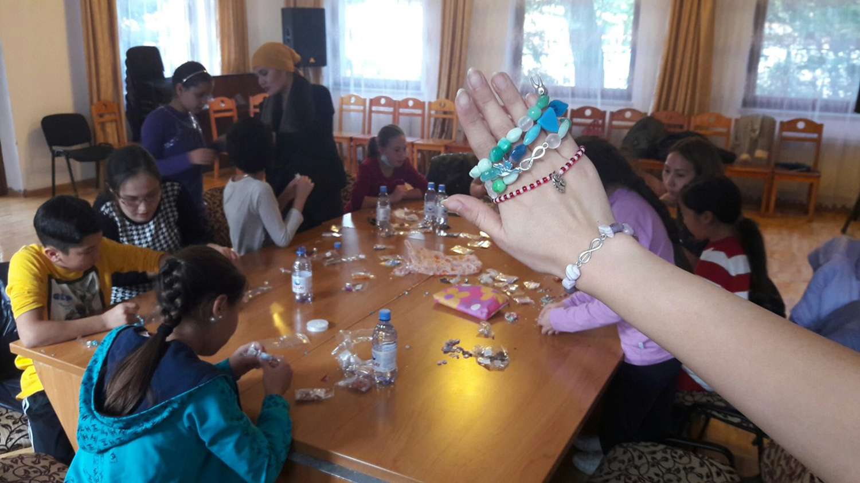

Slide 23

Digital MEDIA BOOT CAMP by Zhanna Tsoy’11

Slide 24
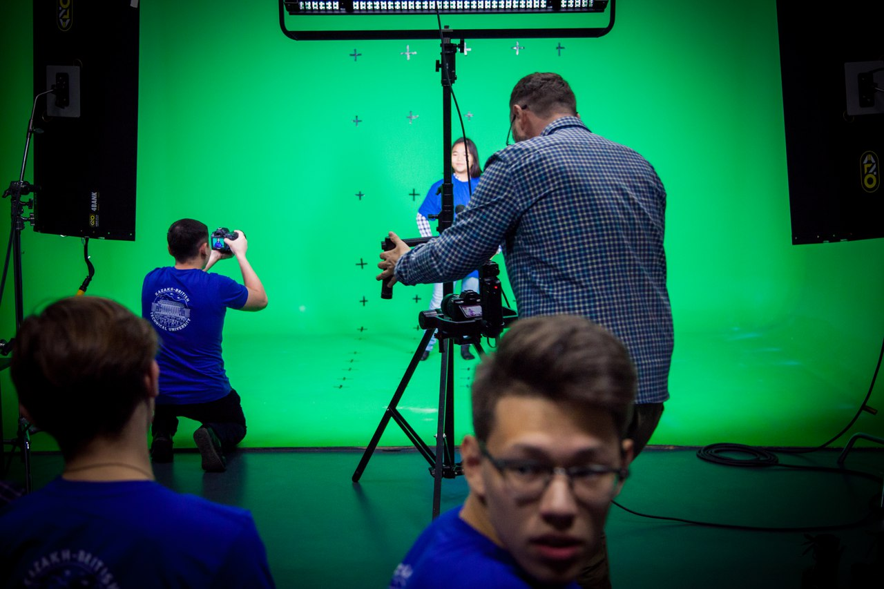
Digital Media BootCamp - is a 4-week cost-free camp,which teaches Digital Media Technologies to 9-11th graders all over Kazakhstan. It gives amazing chance and opportunity to high school students to study 3D modeling, animation, graphic design and visual effects!

Slide 25


Slide 26
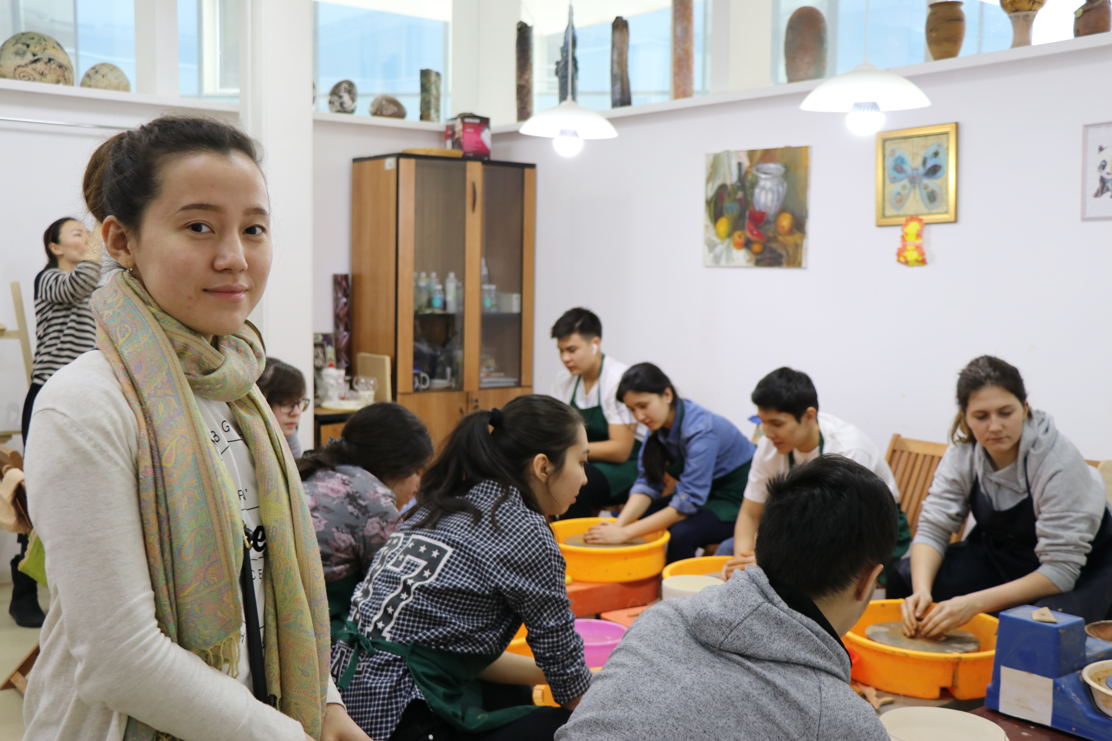
“Pull Up yourself by Boot Camp” by Karina Ibragimova’14

Slide 27
Want to implement summer camp?! Attend a webinar from awesome trainer on Jan 22 at 8 am EST (19:00 Almaty time)! https://zoom.us/j/123223374

Slide 28

ALUMNI ENGAGEMENT INNOVATION FUND

Slide 29
WIN UP TO 25 000$!
Applications for AEIF 2019 will open on February 1, 2019.
AEIF themes for 2019 are:
Empowering Women and Girls
Fostering Economic Prosperity
Building Civic Participation, Good Governance, and Resilient Communities
Advancing Science, Technology, Health, and Innovation
Promoting Inclusion and Educational Opportunity

Slide 30
2019 AEIF TIMELINE
Friday, February 1: The AEIF competition begins at 14:00 ET (U.S. Eastern Time)! Alumni may start submitting proposals and budgets.
Thursday, February 28: The deadline for AEIF proposals and budget forms is 14:00 pm ET (U.S. Eastern Time). This is the final and only deadline. Late submissions will not be accepted.
March & April: Eligible proposals will be reviewed and evaluated.
June: AEIF 2019 semi-finalist projects will be announced.
Late Summer: AEIF 2019 winners will be announced!

Slide 31

Guide to Completing AEIF Proposal Form: General Info:
Project Title (10 word limit):
Create a short title that clearly describes your project. Remember, many people will be
looking at your proposal and a good title will catch their attention. A descriptive title will
also help you promote your project.
Primary location

Slide 32

Project challenge and need
Need or challenge (150 word limit):
In 3-5 sentences, explain what your project is and why it is important for you to carry it out.
What change will your project affect?
Solution or method to address the need or challenge (150 word limit):
Precisely explain what your project is and how many people it will reach. For example, are
you carrying out an awareness campaign, training, mentoring program, etc.? Winning AEIF 2
projects demonstrate innovation by tackling a new issue, using a unique approach, working
with a different group of people, or performing the project in a different location than other
projects.
Project impact (300 word limit):
What are the direct benefits that people or organizations will gain from your project, during
implementation and after completed? What impact or changes (in people, institutions,
attitudes, practices) will you see? Include quantitative information where possible.

Slide 33

Who will be involved?
Beneficiaries (200 word limit):
Describe your target audience(s). Will your project work with a certain age group? For
example, will you primarily work with youth? Or experienced professionals? In which career
fields do they work? Will your project focus on a certain gender? If your project will benefit
several types of audiences, please briefly describe each one and how many people in each
group you will reach.
Local partners (500 word limit):
Projects that have strong buy-in or support from others in the community tend to be more
successful. Who are your project partners and what are their specific responsibilities?
Please note if you have an existing relationship with the partner organization(s) and
describe their role in the project. If you do not have an existing relationship, how do you
anticipate establishing a partnership with the organization(s)? Will you work with a
community center, a university, or a private business? Will you hold events at an American
Space? Will an expert offer their services? Will an organization donate space or resources
for your activities?

Slide 34

Alumni team:
Roles and Responsibilities:
Please indicate the roles and responsibilities of the team leader and all team members.
What experience or knowledge does the alumnus/a have to fulfill the assigned role? Which
activities will they manage?
To identify your team members, you must include the following information about each
member in the form: first name, last name, e-mail address, exchange program, and country
of citizenship.3
Guide to Completing AEIF Proposal Form
Note: You can add up to 5 additional alumni team members, but only three are required for
your project to be eligible. If you have non-alumni working on your project, you can enter those
people in the “Partners” section.

Slide 35
Implementing your project
Implementation Plan and Timeline (750 word limit):
How will you actually make this project happen? Be specific! Precisely describe the specific
actions/activities the alumni team will take and indicate who will do them. and activities should also be included.
Communication Plan (350 word limit):
How will you promote your project to the public and beneficiaries?
Include social media, websites, print news, or other forms of media you will use to share information about your
project.
Note: Interim and final reporting is required for winning AEIF projects. Please be prepared to
develop a reporting plan to share information about the success/impact of your project.
Evaluation (350 word limit):
How will you evaluate the success/impact of the project? How will your team know if the
project was successful or had an impact? Include any tools or methods you will utilize to
measure results such as surveys, interviews, focus groups, meetings, analytics, metrics, etc.
Sustainability (350 word limit):
AEIF funds can only take your project so far. If implementation is successful, how will your
project continue to make an impact on the community? How do you plan to continue this
project beyond this initial funding year?

Slide 36
https://alumni.state.gov/aeif#
Important tip: register in this website in advance, because it may take a long time to go through authorization.

Slide 37

Global Village
The Iacocca Global Village for Future Leaders is an intensive, five-week program on the campus of Lehigh University that teaches adult professionals business, entrepreneurship and leadership skills while preparing them to thrive in a global community.
Villagers are a mix of undergraduate students, graduate students, young entrepreneurs and professionals from 35-40 countries around the world.
The 2019 program runs June 22 to July 27.
FLEX and YES Alumni Scholarship candidates must apply by February 15
Link: https://global.lehigh.edu/iacocca-institute/global-village

Slide 38
Tip: It’s better to apply for Global Village when you graduated from university/you have enough years of experience in the field, which you would like to develop during the Global Village

Slide 39
FINALLY! I am done speaking!
Questions? Comments? Concerns??

